Slide 1

Group 11
Level 4/5 Group 11
Razvan Muresan
Tyler Martignetti
Joseph Shuttlewood
John Rance
razvan muresan
joseph shuttlewood
tyler martignetti
john rance

Slide 2

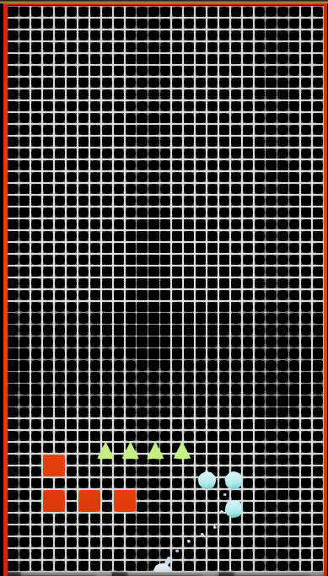
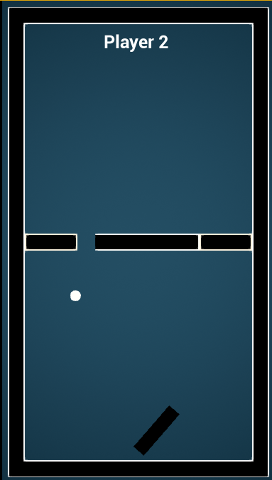
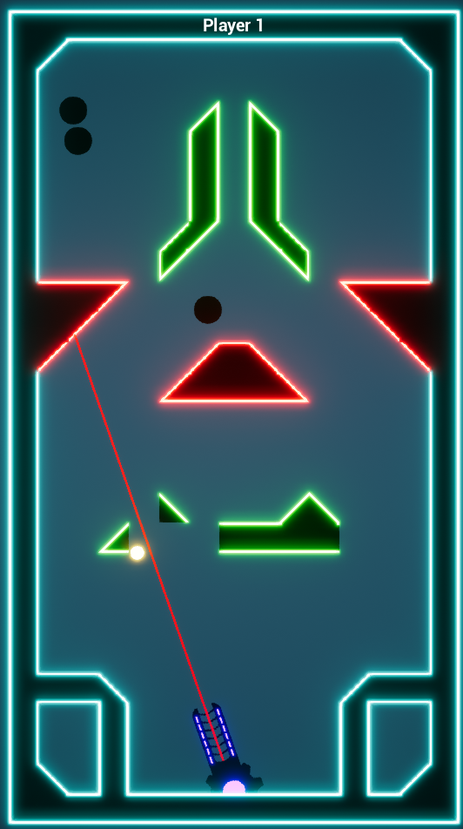
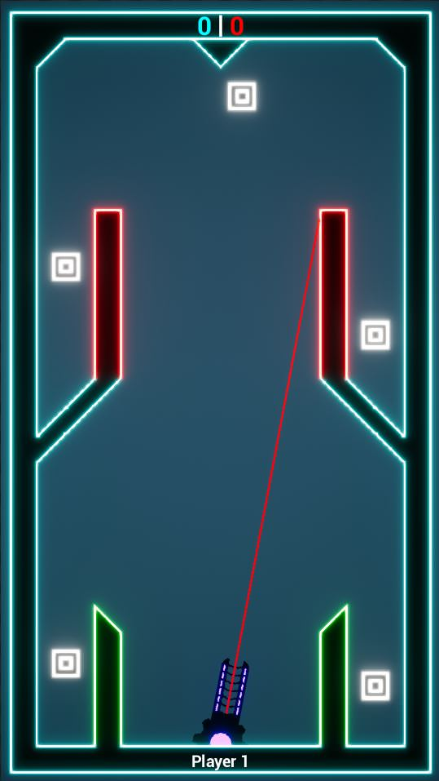
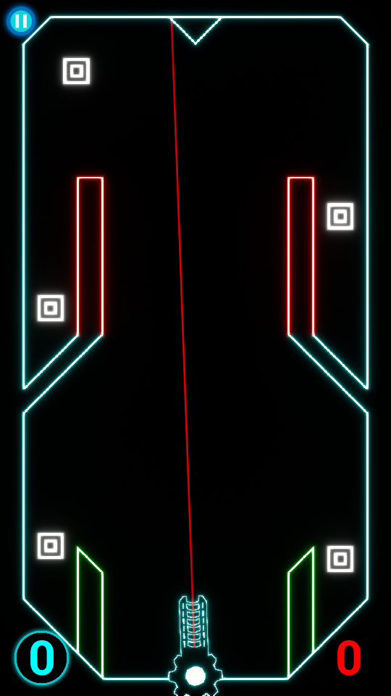
Our Game & iterations
16th February
21st February
26th February
5th March
Today

Slide 3
RELATION TO THE BRIEF
The Gameplay Experience:
Engaging and Focused – Requires active concentration, timing and prediction
Polished – Using player feedback to refine the gameplay and levels
Teaching the Game – How to Play Screen

Slide 4
Feedback received
UI Elements
Score
Player turn indicator
Pause button and hardware buttons
Tutorial Levels
Difficulty of Levels
Design choices – Neon theme

Slide 5
Critical mechanical changes
Moving blocks were changed drastically in every single level
Removed targets from bottom corners of levels
Removed a lot of triangle blocks

Slide 6
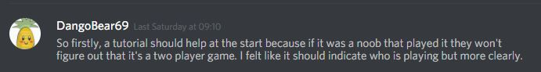
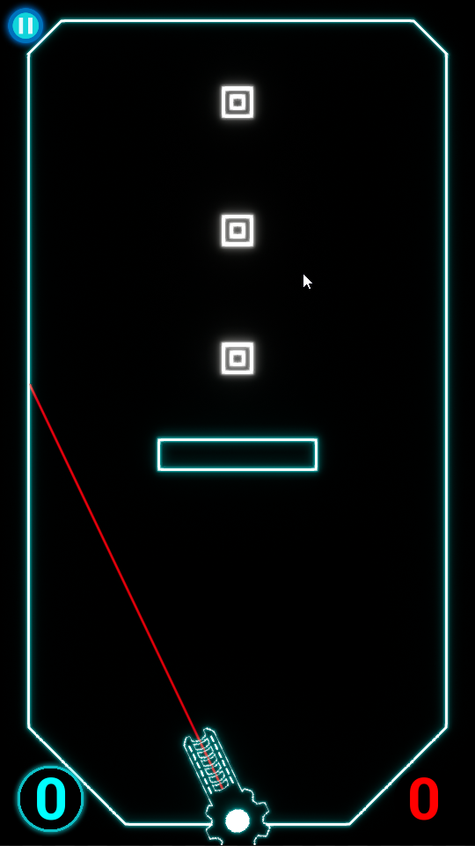
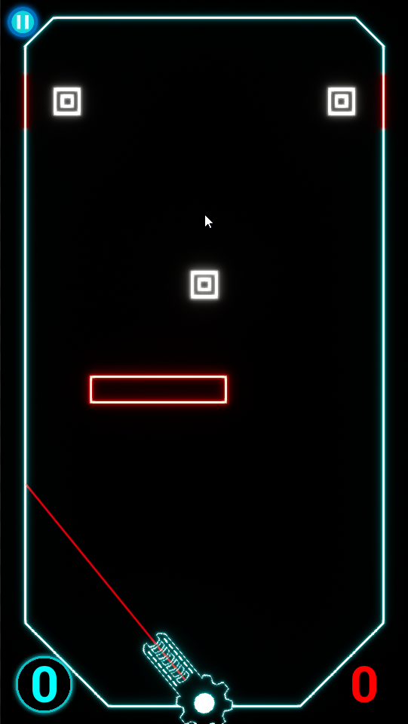
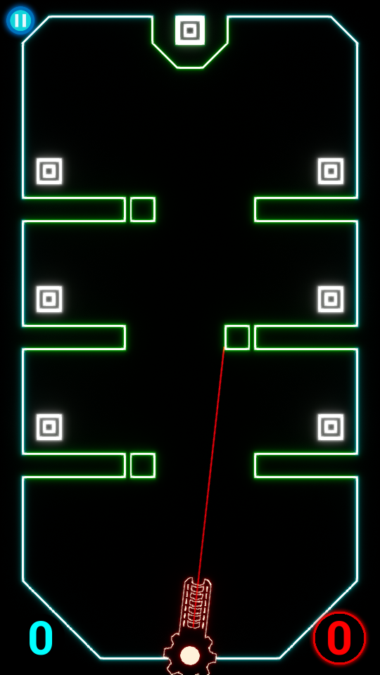
Feedback
Tutorial Level 1
Tutorial Level 2
Tutorial Level 3

Slide 7
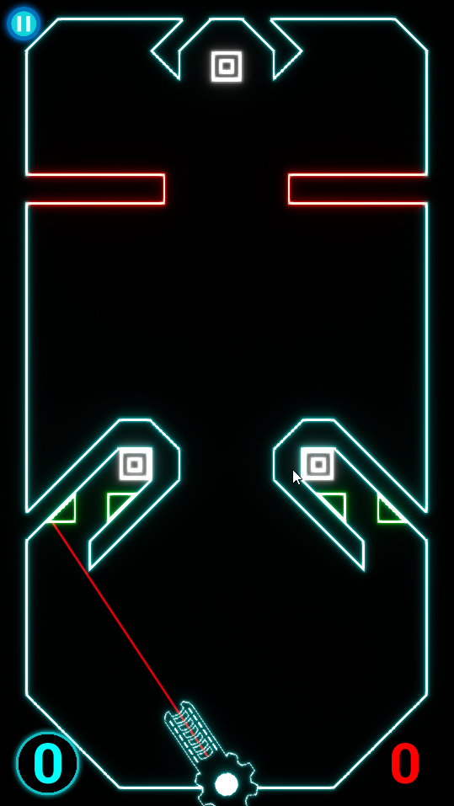
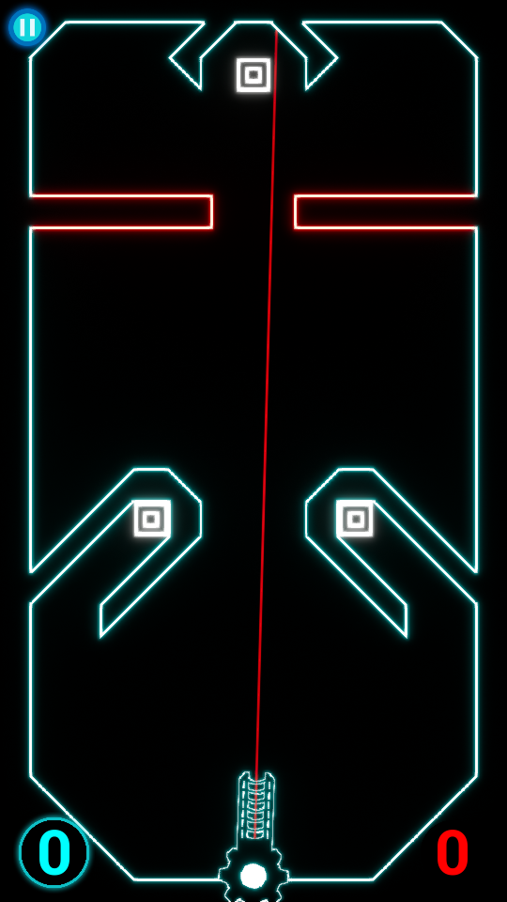
Iterations based on feedback

Slide 8
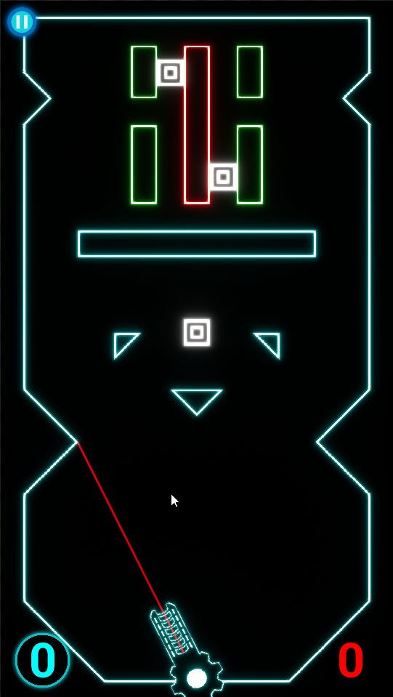
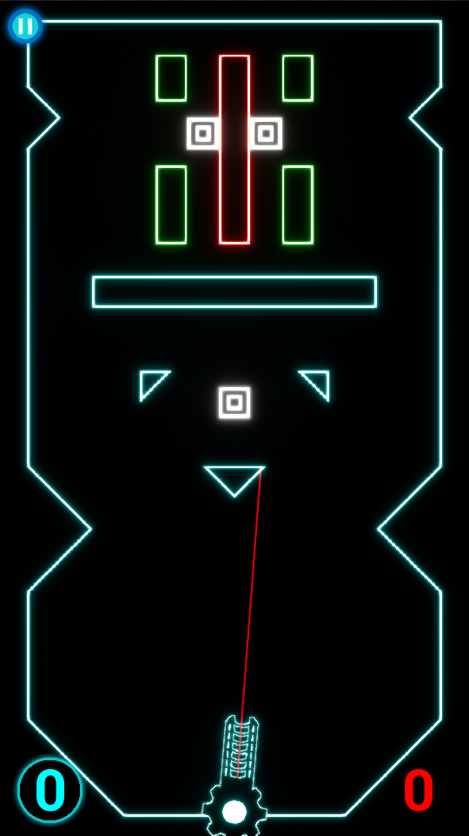
Iterations based on feedback

Slide 9
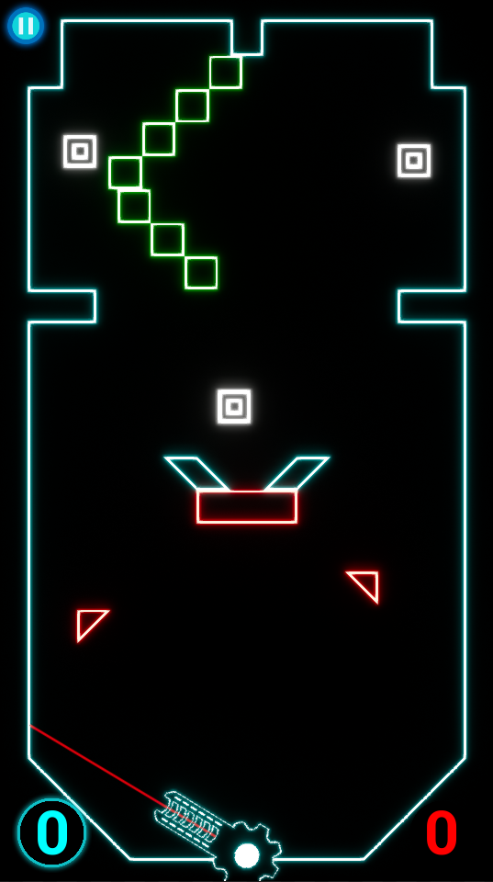
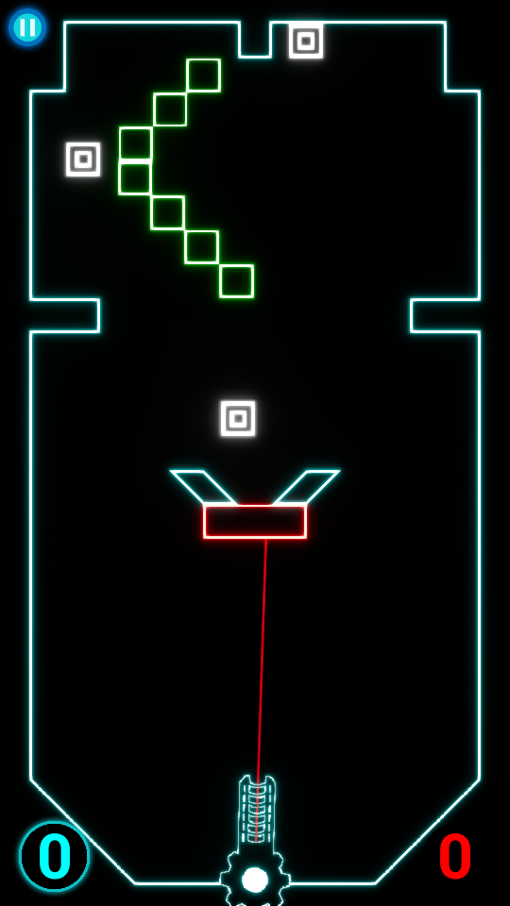
Iterations based on feedback

Slide 10
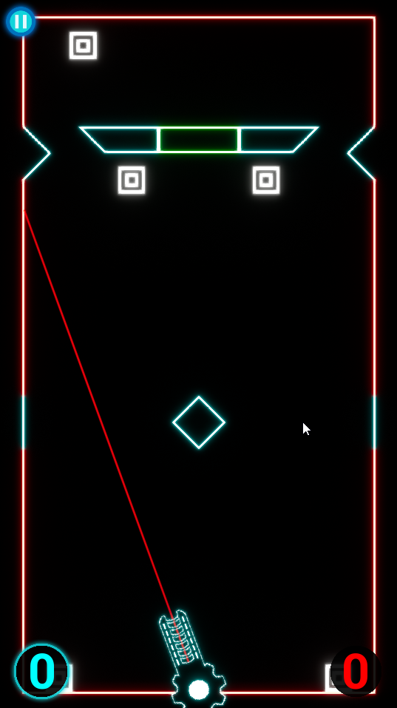
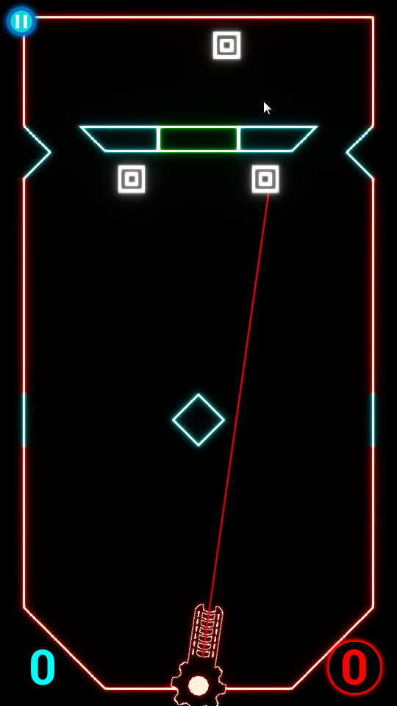
Iterations based on feedback

Slide 11
Plans for the next two weeks
Balanacing and playtesting the current levels
Refining the sound system
Adding vibration for mobile build
Refining design and affordances
Storing settings between play sessions
Customization options for cannon and ball trail

Slide 13
DEMO

Slide 14
Questions

